Slide 1
Computer networks
Network administrators are here to help you!
Open a ticket on https://support.scientificnet.org

Slide 2
Computer networks
What is a network
  Computers
  External connection
  Terminals → Virtualization
  Printers
  Stand-alone hard disks
  VoIP telephones
Server-client architecture

Slide 3
Virtualization
Virtual Machine
  an operating system running on a powerful computer but appearing on a terminal
    re-use old computers
    everybody has the very same operating system
    centralized maintenance
    use software without installing it on your computer

Slide 4
Virtualization
VMware at unibz
  https://desktop.scientificnet.org
    it uses data from \\ubz01fst.unibz.it
  download the client on your device
    for old versions to enable access to local disks from
    Settings -> Options Tab -> Shared Folders
    Mac: Preferences -> Sharing
  use it via web
    but cannot access your local disk

Slide 5
Virtualization
Virtual Machine
  another operating system running on the same computer
    use different operating systems
    duplicate your VM, test bad things and then easily reset everything
  Windows: Hyper-V
  Mac: VirtualBox
  get Windows and Office from http://knowledge.scientificnet.org/software

Slide 6
Transfer speed
Network areas
  Local Area Network (LAN, Intranet)
  Wide Area Network (WAN, Internet)
  Virtual Private Network (VPN)
Speed in “bits per second” (bps)
Ethernet 10 Mbps
Fast Ethernet 100 Mbps
Gigabit Ethernet 1 Gbps
Wireless up to 300 Mbps

Slide 7
World Wide Web
WWW is a part of the Internet organized in hypertexts and accessible using a browser
Other things going on on the Internet are
  emails
  files transfer systems
  chat services
  computer to computer communications
  …

Slide 8
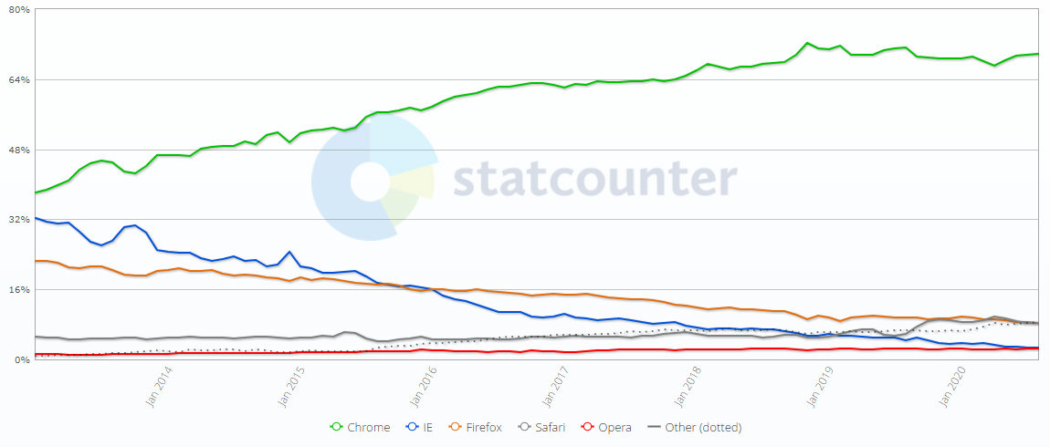
Communication programs
Web browser
gs.statcounter.com

Slide 9
Invisible Web
Deep web: web pages which are not linked
  personal pages
  reserved information
  payment pages
  Pages are not indexed by search engines
Dark web: web pages not accessible using a standard browser
  Tor browser: user and website are anonymous
  drugs, identities, child pornography, weapons
  journalists and libertarian activists

Slide 10
Posta Elettronica Certificata – PEC
Standard email
  No guarantee of sender’s e-mail address identity
  No guarantee of sender’s identity
  No guarantee that content has not been altered
  No sent proof
  No dispatched proof
  No read proof
PEC address is handled by a provider with special techniques and has word “pec” in the address

Slide 11
Posta Elettronica Certificata – PEC
PEC to PEC: like a Raccomandata con Ricevuta di Ritorno (Certified Mail with Return Receipt Requested in USA, Registered Mail in Canada)
  Sent proof
  Dispatched proof
  (in practice also) sender’s address identity and unaltered content
  PEC to standard email: like a Raccomandata Semplice
  Sent proof
Standard email to PEC: like a normal letter
Sent and dispatched proves are legal proves

Slide 12
Search engines
Crawler technique on the visible web
Google PageRank algorithm
Search tricks:
  Use many keywords
  Quotations
  Advanced search

Slide 13
Slow connections
OLD
TECH
Names | Equipment | Effective speed | Notes
PSTN analogical dial-up | telephone line and modem | 56 Kbps | Telephone is busy during connection
ISDN | ISDN telephone line and modem | 128 Kbps | Telephone is busy during full speed connection
GPRS 2G | GSM mobile phone | 100 Kbps | Telephone is busy during connection
EDGE 2.5 G | modern GSM phone | 300 Kbps

Slide 14
Broadband connections
Name | Equipment | Maximum speed | Notes
ADSL | telephone line and modem | 1 Mbps in upload 20 Mbps in download
Optical fibre | telephone line and modem | 1000 Mbps
UMTS 3G | 3G mobile phone | 5 Mbps in upload 40 Mbps in download
LTE 4G | 4G mobile phone | 100-1000 Mbps | Speed depends on your 4G type and coverage
5G | 5G mobile phone | 1-10 Gbps | Still under development in 2021

Slide 15
GDPR 679/2016 on personal data
No specific rule
Does not apply for exclusively personal use
Good security measures
  authentication with login + password or alternatives
  specific permissions to different people
  training or instructions
  constant backup
  programs update
  sensitive data must be encrypted or unidentifiable
    race, religion, sex, association, ethics
    justice, medical, genetic

Slide 16
Cryptography
Military scrambling technique to make text unreadable
  Encryption: COMPUTER → FRPSXWHU
    move letter forward by +3 places
  Decryption: move letter by -3 places
    FRPSXWHU → COMPUTER
Algorithm is well-known
The keys +3 and -3 are secret and may be changed for every message

Slide 17
Cryptography
Two problems:
  even with a complicated algorithm, this encryption system can be broken using computers who try all the possible combinations until you get something readable
  it is symmetric: it is easy to deduce a key (-3) once you know the other one (+3)

Slide 18
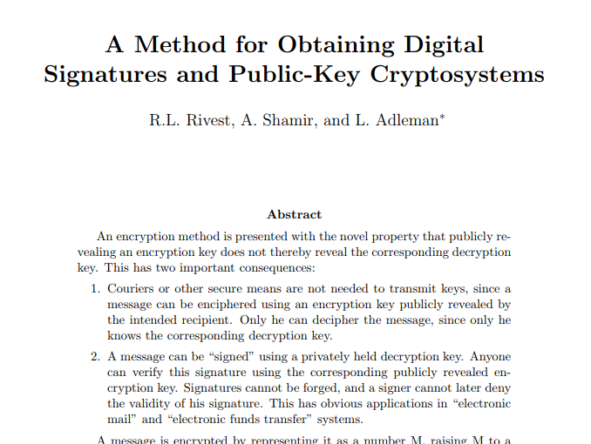
Asymmetric cryptography
1978, RSA algorithm published on Communications of the ACM

Slide 19
Asymmetric cryptography
https://en.wikipedia.org/wiki/RSA_(cryptosystem)
Keys are generated using huge prime numbers and are extremely hard to guess by computers trying all combinations.
It is asymmetric: if you know a key there is no way to deduce the other one

Slide 20

Cryptography for information transmission
B
message 1
encrypt
G#4hg!
decrypt
message 1
C
encrypt
f@çd*s
decrypt
message 2
A
message 2
D
message 3
encrypt
È^£(iw,
decrypt
message 3
B
message 1
encrypt
G#4hg!
decrypt
Trb:-ò°§
C
message 2
encrypt
f@çd*s
decrypt
Dr4^\|ò9
D
message 3
encrypt
È^£(iw,
decrypt
%$&/òL

Slide 21
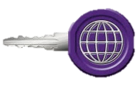
Cryptography for data storage
A
secret data
encrypt
secret data
A
D(£ò§*+]dH
decrypt
A
secret data
encrypt
%£)(“84jhgds?ì
D(£ò§*+]dH
decrypt

Slide 22
Digital signature
  It is not your scanned handwritten signature!!!
  Generate a couple of keys and use:
    private key for encrypting
    public key for decrypting and publish it!
  Encrypt the document and attach it to its original version
  If decrypting the encrypted part with your public key gives the same document, it has been signed by you!

Slide 23
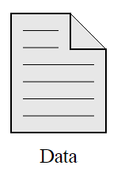


Digital signature
Placing my signature
encrypt with
my private key
document
encrypted document
signed document
Verifying my signature
decrypt second part with my public key
If the two parts are the same, signature was really done with my private key.
If the two parts are different, signature was not done with my private key
signed document

Slide 24
Digital signature
document
B
decrypt
A
document
encrypt
G#4$h&à?-2y
decrypt
C
document
decrypt
document
D
2?=zx:-ki
B
decrypt
false document
encrypt
Y&”:ò[fgj?’^d
decrypt
C
2?=zx:-ki
decrypt
2?=zx:-ki
D

Slide 25
Digital signature
Law 82/2005
  Keys given by certification authorities
Use in combination with PEC
Keys expiration
Temporal mark

Slide 26
Comparison with handwritten signature
 | Digital signature | Handwritten signature
Who can sign | Needs keys from certification authority and proper tools | Everybody instantly
Who can verify | Everybody (with proper program) | Handwriting analysts
Verification reliability | Sure for some years | Subjective in dubious cases, no time limit
Temporal duration | Some years (can be renewed) | Until other reliable signatures are available
Mass signatures | Some seconds for all documents | Some seconds per document
Date reliability | Objective if temporal mark | Based on uncertain elements (paper’s and ink’s age)
Content alteration | No possibility | Words can be added in blank spaces

Slide 27
Electronic vs digital signature
Electronic signature
  automatic signature through username and password
Qualified electronic signature
  and a certification authority guarantees it
Digital signature
  and uses cryptography

Slide 28
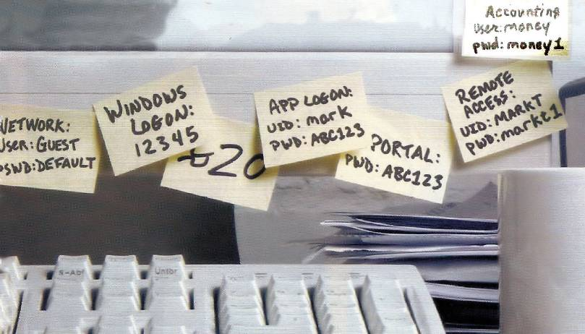
Passwords

Slide 29
Passwords
What can be done with your password?
  Steal personal data
  Steal other people’s data
  Steal money
  Delete and modify data
  Steal identity
  Start illegal activities

Slide 30
Passwords
Most people have the following passwords:
https://en.wikipedia.org/wiki/List_of_the_most_common_passwords
A standard computer can try billions passwords per second
password | dragon | monkey
123456 | pussy | 696969
12345678 | baseball | abc123
1234 | football | 12345
qwerty | letmein

Slide 31
Passwords
Good practices:
  Avoid personal data in the password
  Change password often
  Minimum 8 characters
  Mix letters, strange characters and numbers
  Do not use words
  Use different passwords for different purposes
  Beware of passwords stored on device
Test your password robustness on
https://howsecureismypassword.net
What to do in case of employee’s absence

Slide 32
Remembering passwords
Keep them on your unprotected smartphone
Keep them on a file on your computer
Remember them by hearth
Write them down on a handbook
Send them to yourself
Use a password manager
  Computer/smartphone program which creates an encrypted file with all your password
  Have a copy of the encrypted file with you and remember only that file’s password

Slide 33
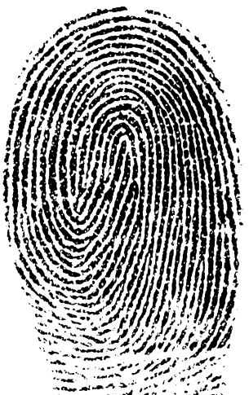
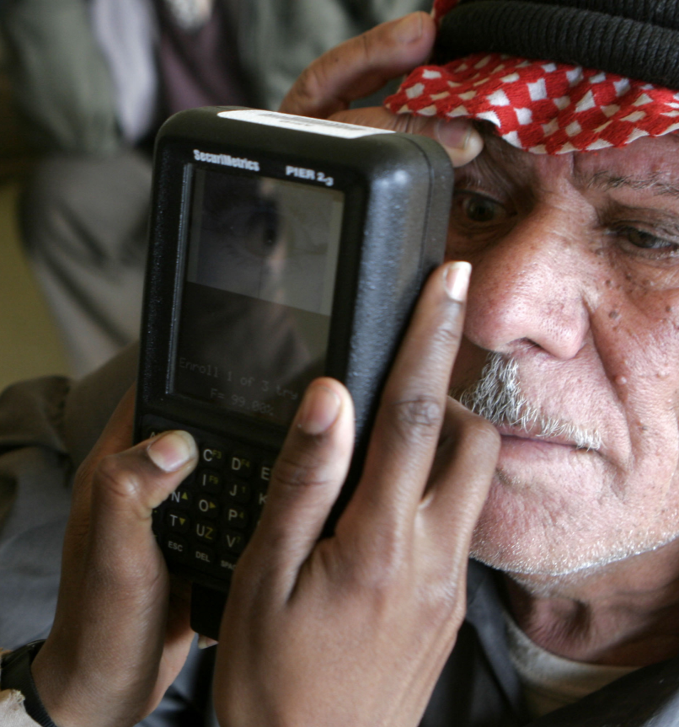
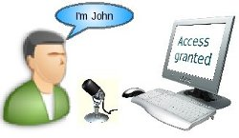
Alternative to password
Biometric identification methods
  fingerprint
  face recognition
  iris recognition
  voice identification

Slide 34
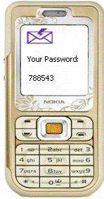
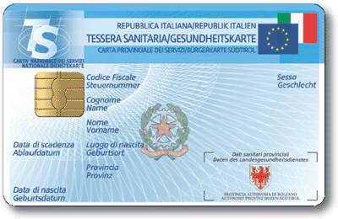
Two-factors authentication
Adding physical methods to standard password
  smartcard
  OTP on app
  phone SMS
  phone call
  notification on app

Slide 35
Viruses
What does a virus do?
  Infect
  Survive
  Duplicate
  Damage
Virus infection symptoms
  computer is slow to start
  unwanted and annoying pop-ups
  many system errors

Slide 36
Viruses
User’s responsible behaviors
  downloaded files and email attachments
  CD, DVD, USB pendrives
  strange websites
  updated programs
  updated antivirus
  beware when installing free programs!
Anti-viruses
  Checking the whole hard disk
  Checking suspect files
  Always running

Slide 37
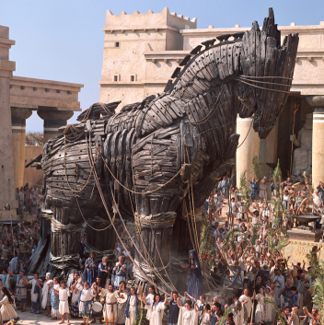
Types of viruses
Trojan horse
  looks like a good program
Key logger
  records your keyboard activity (to get passwords)
Back door
  opens a port on your computer (to let external users in)
Adware
  displays advertisement
Spyware
  spies your activity (to get passwords or for spam targeting)
Ransomware
  demands money to avoid damage or justice problems

Slide 38
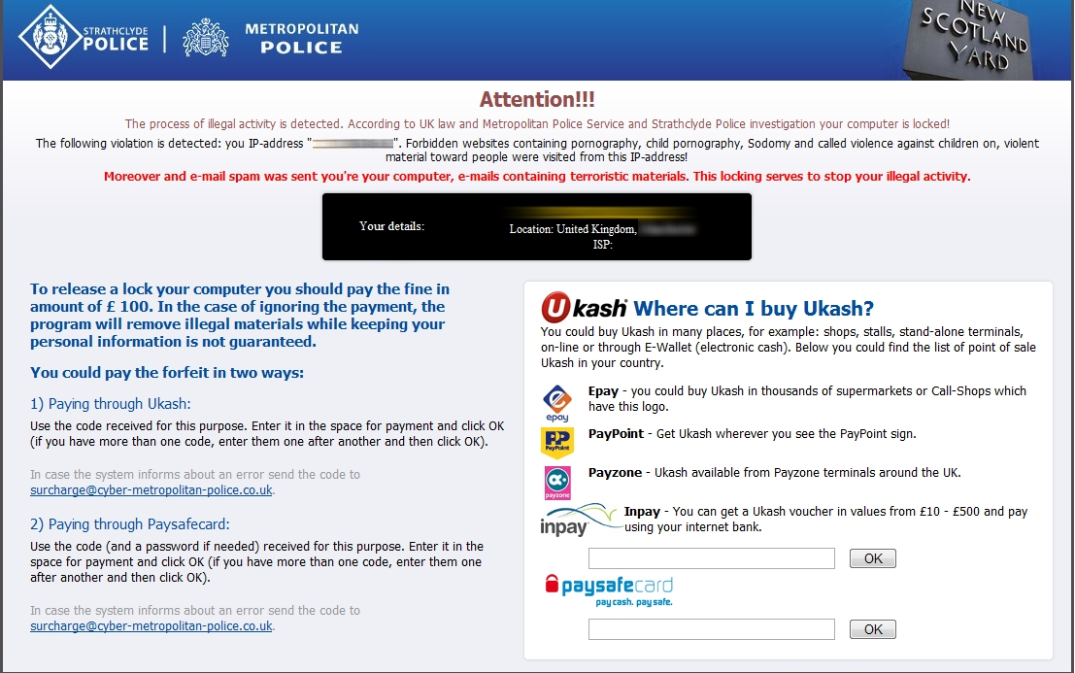
Ransomware

Slide 39

CryptoLocker/WannaCry
Trojan
+ hiding extensions
+ encryption
+ ransomware
= CryptoLocker
  It arrives via email as document.pdf.exe with this icon
  You believe it is a PDF and click on it
  It is instead a program and it runs
  It starts to encrypt all your documents
  When you realize it is too late!

Slide 40
CryptoLocker/WannaCry
  It asks you 400 USD (paid via anonymous vouchers or Bitcoin) to get the decryption keys
  Do you pay?
In 6 months its creators earned between 3 and 27 millions USD
A consortium of national police forces started to investigate and get the list of private keys
Several other clones have appeared

Slide 41
Spam
“unsolicited” “unwanted” “bulk” email
  Advertisement: gambling, pornographic websites, medicines, risky investments, software…
  Frauds
  Phishing
Sender is always counterfeited
Do not click on links! Do not answer!!!
Where do they get my email address?
Antispam and blacklists

Slide 42
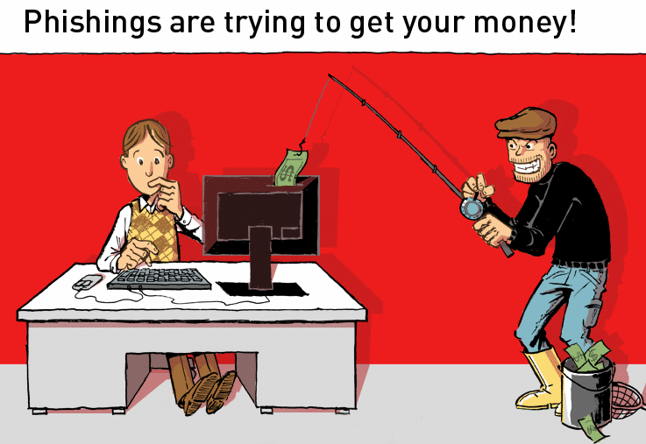
Phishing

Slide 43
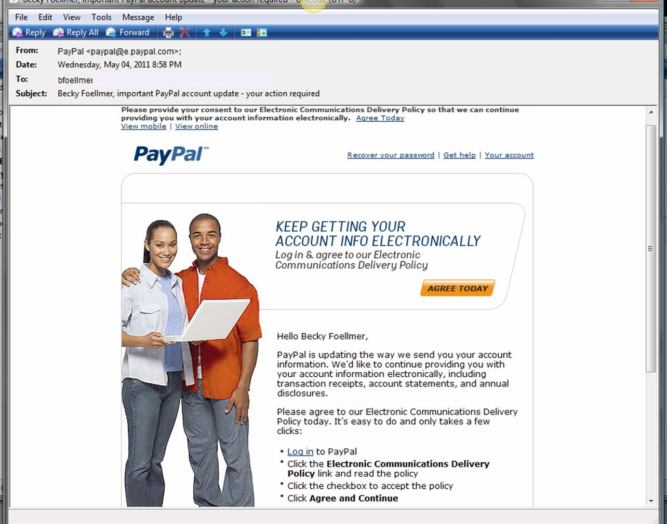
Phishing

Slide 44
Phishing example
Billions of emails sent with very small cost
Millions arrive to existing users
Thousands of users read the email
Some readers believe in the email
Get some money from each user… more than initial cost

Slide 45


Safe navigating
Navigation security
  Phishing
  Viruses
    Download → Save → Antivirus → Open
    Avoid visiting and downloading from untrustworthy websites
    Keep browser and operating system up-to-date
  Intercept your data
    Secure connection SSL: httpS

Slide 46
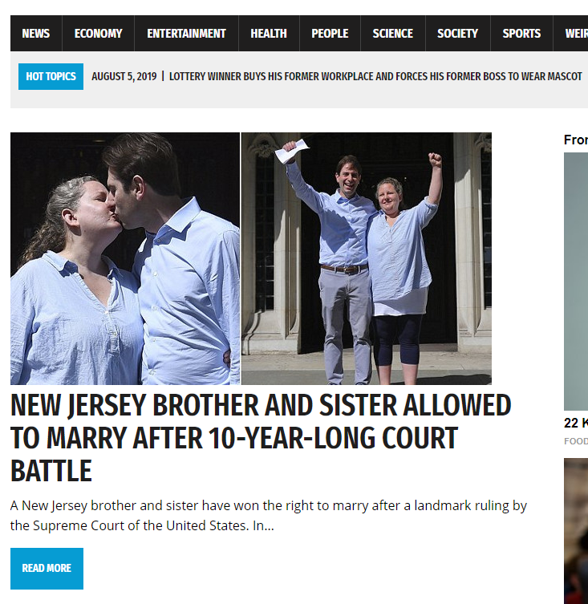
Fake news
Originally only funny little stories
Now source of income through advertisement banners

Slide 47
Attacks from outside
Distributed Denial of Service DDoS
  zombie computers
Firewall
  which internal program
  which external address
  what amount of traffic
  which kind of data
Windows 10 Firewall

Slide 48
Backup
Why backup?
  Source: The Cost of Lost Data. The importance of investing in that “ounce of prevention” by David M. Smith

Slide 49
Backup
What to backup?
  Your data files
  emails, contacts, calendar
  Program configuration files
  Difficult-to-find stuff
Where to backup?
  another hard disk
  online backup systems
    Dropbox, Google Drive, Microsoft OneDrive, iCloud, Box, Amazon Drive
  RAID techniques

Slide 50
RAID – Redundant Array of Independent Disks
RAID 0
  2 disks, fast
RAID 1
  2 disks but space as for 1, safe vs crash, 24h service
  Most common solution
RAID 10
  4 disks but space as for 2, fast, safe vs crash , 24h service
None of these techniques is safe versus viruses or human errors!

Slide 51
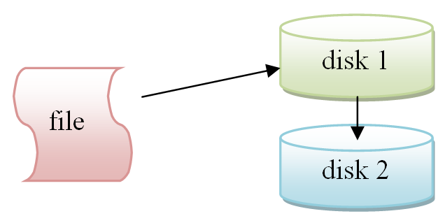
RAID 1

Slide 52
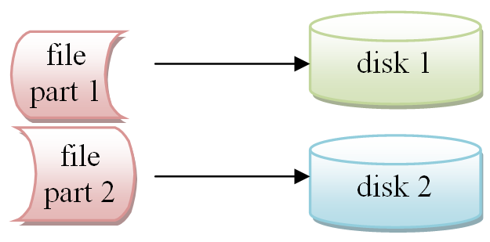
RAID 0

Slide 53
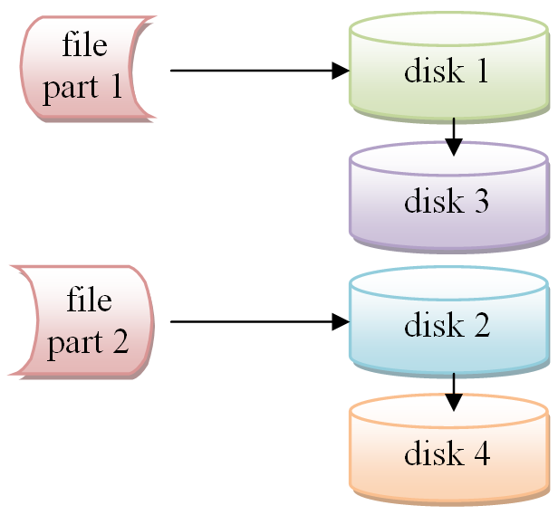
RAID 10

