Slide 1
Single table database in normal form
1
Fields and records
Normal form
Header in the first line
Same content for every field
Each record refers to a single object
Records are independent
Records and fields order does not matter
No field which can be calculated

Slide 2
Relational database
2
Primary key
ID
Problems of single table databases
information redundancy → relation
empty fields
Relational database is “a collection of structured tables connected via relations”
Foreign key
Field A of table 1 is related to field B of table 2
“one to many” or “many to one”: University courses

Slide 3
Relational database
3
“one to one”: Countries and flags
“many to many” relation
junction table: Houses property, Students exams
joining several tables: car’s parts
details table
foreign key with more than one relation
Temporal vs static databases

Slide 4
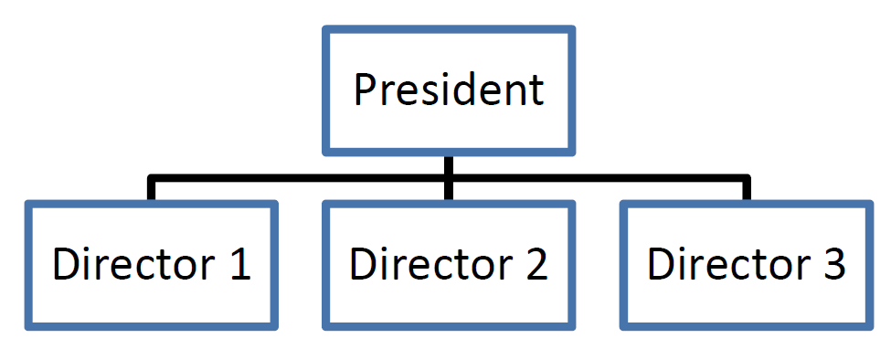
Relational database
Modeling other structures
Hierarchical
Process
Orphan records and referential integrity
4

Slide 5
Design a database
Read and understand
read 3 times the description and have a very clear idea of the practical situation
External tables
start with the external tables, the ones which are the pillars of the database. Usually these are identified by things which rarely change, such as people, places, objects. These are often evident from the database's description

Slide 6
Design a database
Relations
decide which relation these tables have among themselves, check that the relations that you decide are logical (according to real situation) and are compliant with database's description
now build the appropriate relations (inserting, if it is necessary, foreign keys) or insert appropriate junction tables
Relations check
one-to-many and many-to-one properly oriented
no relation is one-to-one
many-to-many → junction tables and eventually details table,
“1” side is really a “1” side and does not instead need a many-to-many relation

Slide 7
Design a database
Check
check again that the database is compliant with the requests and that all the relations make sense
check also that the database is able to satisfy the final question (probably you'll have to add fields)
Fields
put all the fields' types and requested options
write a description of the not obvious fields
Queries
write the requested queries, avoiding to use fields that you do not have.
Justify every non-standard choice you take

Slide 8
Home exercises: Your library
It is a database of your books and their authors.
Suppose that each book has only one author.
Typical fields may be title, number of pages, genre, language, price, publishing year, edition, author's name, surname, nationality, date of birth.
Think at the content!
Books
Authors
Think at the structure!
Many to one relation
Draw the schema!

Slide 9
Home exercise: students, exams and lecturers
It is a temporal database which handles data regarding students and their exams and lecturers
Typical fields may be exam’s name, semester, credits, language, and student’s first name, last name, enrolment year, degree course, student number.
Think at the content!
Students
Exams
Professors
Think at the structure!
Many to many relation → you need two extra tables
Draw the schema!

